Slide 1
Heart Disease Analysis Using Power Bi
Name : Dhanasekaran V
Course : Data Analytics & Data Science
Batch : April 2025

Slide 2
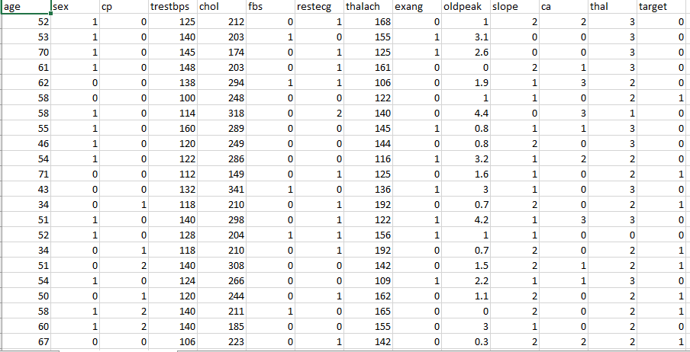
Dataset Overview
Source : Kaggle.com
Rows : 1025
Column : 14
Key Columns :
Age
Gender
Blood Pressure
Cholesterol
Thalassemia
Slope Type

Slide 3
Data Cleaning Process
Removing Null / errors
Replacing Values
Standardized Data Types
Renaming Columns
Creating Age Groups
Eliminated Null Values And Duplicate Records To Ensure Data Consistency.
Replaced Cryptic Values (Like Cp, Fbs) With Meaningful Labels
Converted Codes (Eg.,0 Into Female & 1 Into Male) Into Readable Categories
Set Appropriate Data Types (Text, Whole Number, Decimal) For Each Column
Added New Column To Classify Patients As Young, Middle Age ,Orsenior

Slide 4
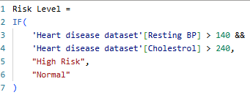
DAX Functions
Total Patients - The Total Count Of Rows
Patience With Disease - The Patient Has Disease = “Yes”
Disease Percentage - Percentage Of Positive Cases
Average Cholesterol - Across All The Patients
Average Heart Rate - Peak Heart Rate Trend
Average Blood Pressure - Mean Of Resting Pressure
Total Males - Total Number Of Males Diseased
Total Females - Total Number Of Female Diseased
Risk Level - The Risk Level Of The Patient By Diseased

Slide 5
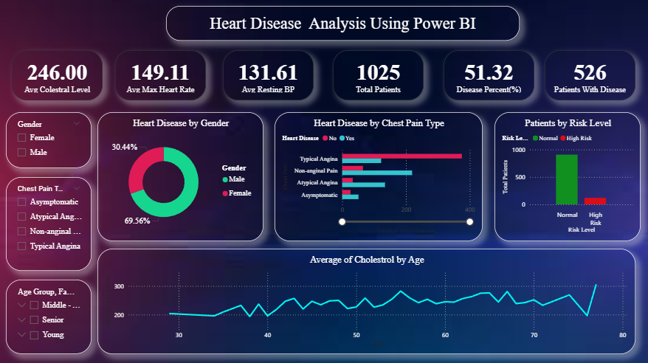
Dashboard Overview

Slide 6
Findings :
Over 50% Patients Diagnosed With Heart Disease
Males Had A Higher Prevalence
Typical Angina Patients Were At Greater Risk
Cholesterol Rises Steadily With Age
High BP + High Cholesterol = High Risk Flag
Insights :
Early Screenings Needed For Middle-aged Males
Focus On Cholesterol Control
Risk Dashboards Helpful For Clinics

Slide 7
Conclusion :
This Power BI Project Successfully Transformed Patient Health Data Into Actionable Insights For Heart Disease Analysis.
Using Power Query And DAX, We Created A Clean, Interactive Dashboard That Highlights Key Patterns Like High-risk Groups, Chest Pain Impact, And Age-related Trends.
The Project Demonstrates How Data Visualization Can Enhance Decision-making In Healthcare.
Real world Applications :
Hospital Dashboards: Monitor heart health KPIs and patient risk levels
Preventive Care: Identify high-risk individuals for early intervention
Clinical Support: Assist doctors with data-driven patient insights
Healthcare Research: Build a base for ML models and health studies

